Slide 1
CONTENTS
Domain Selection
Title Selection & Justification
Abstract
Objective
Introduction
Literature Survey
Existing system
Proposed system
Minimum System Requirements
System Architecture
System Design (UML Diagrams)
Snap Shots
Conclusion
References
Future Enhancements

Slide 2
DOMAIN SELECTION
The automotive valuation landscape is inherently dynamic, influenced by multiple factors. Machine learning, with its adaptability and capacity to recognize patterns within vast datasets, emerges as the ideal domain to address the intricacies of predicting car prices accurately.
The decision of selecting the domain depended on the following:-
1. DYNAMIC NATURE OF AUTOMOTIVE VALUATION : The dynamic nature of the automotive industry demands adaptive and agile solutions to navigate evolving market trends and consumer preferences.
2. UNLEASHING PREDICTIVE POWER : the Random Forest algorithm in our project, offers predictive power that goes beyond the limitations of conventional approaches.
3. ADAPTABILITY TO DIVERSE FACTORS : accommodates diverse factors, from traditional attributes to emerging trends, amplifying the model's predictive capability.

Slide 3
4. PRECISION & ACCURACY : Machine learning techniques excel in capturing complex patterns, resulting in a predictive model that attains unparalleled precision and accuracy in forecasting car prices
5. TRANSPARENCY AND FAIRNESS : The model learns and adapts from a diverse dataset, mitigating biases and contributing to a fairer pricing mechanism, addressing concerns of overcharging and promoting ethical practices.
6. SCALABILITY AND REAL-TIME ADAPTATION : Machine learning models inherently scale with the volume of data. As the dataset grows, our model's capacity to adapt and refine predictions in real-time ensures its relevance and accuracy.
7. USER-CENTRIC PREDICTIONS : Our application's intuitive interface, empowered by these domains, ensures users can effortlessly input diverse factors, making the car price prediction process accessible and user-friendly.

Slide 4
TITLE SELECTION & JUSTIFICATION
The process of choosing a title for this project holds more significance than the label alone. It is a deliberate fusion of "Car" to signify the automotive landscape and "Quintessence" to convey the project's core values. This amalgamation reflects our project's holistic approach, encapsulating the diverse elements contributing to our predictive model, from advanced algorithms to seamless web integration.
It serves as a beacon, symbolizing the project's mission of providing users with an essential and accurate tool for informed decision-making in car purchases.

Slide 5
KEY CONSIDERATIONS -
MACHINE LEARNING : Using Machine learning algorithms, was driven by its ability to handle complex datasets and provide accurate predictions. Its versatility and capability to mitigate overfitting make it an ideal choice for our diverse car pricing.
WEB INTEGRATION : The integration of this project with the web ensures a user-friendly and visually appealing platform. It collectively contributes to an optimal and engaging user experience. The technologies seamlessly integrate with each other, fostering a cohesive ecosystem. It also ensures real-time access to data, enabling efficient model training and prediction.
SCALABILITY : Technologies are scalable, capable of accommodating a growing dataset and user base.

Slide 6
ABSTRACT
In the dynamic landscape of India's automobile market, where transparency in car pricing is imperative, this project introduces a transformative approach using the Random Forest algorithm.
The study harnesses a robust dataset comprising over 6000 elements, significantly surpassing previous endeavors. The larger dataset contributes to heightened predictive accuracy, marking a substantial advancement in comparison to existing projects.
A pivotal aspect of our initiative lies in harnessing the power of machine learning models and the integration with web applications and the advancements in predictive modeling is at the core of our initiative.

Slide 7
Web integration ensures an effortless and interactive user experience, allowing users to input diverse factors influencing car prices easily. This user-friendly interface enhances accessibility and provides clear and transparent price predictions, facilitating a rich user experience.
This enables us to achieve unprecedented accuracy levels, providing customers with a robust tool for making well-informed decisions, we hope to curb instances of overcharging and deceptive practices.
By mitigating scams and malpractices, our project not only contributes to the evolution of predictive modeling in India's automotive industry but also promotes transparency and fairness, fostering positive change for consumers.

Slide 8
OBJECTIVE
The objective of the ‘Car Quintessence’ project is to develop a user-friendly web application that leverages a trained Random Forest Regressor model.
The application allows users to input car parameters, such as Km driven, model, year, fuel type, etc and receive accurate predictions of car prices. Utilizing a dataset collected from reputable sources, the goal is to provide individuals with a simple and effective tool for estimating car values based on machine learning insights, enhancing the user experience in the process.

Slide 9
INTRODUCTION
CHALLENGES IN AUTOMOTIVE VALUATION : In the realm of automotive valuation, a persistent challenge has lingered – the lack of a precise and transparent mechanism for predicting car prices. Traditional methods fell short in capturing the nuanced factors influencing prices, paving the way for our project to address this critical gap.
HISTORICAL INEFFICIENCIES : The inadequacy of the older methods prompted our foray into the development of a sophisticated predictive model, poised to overcome the inefficiencies of the past.
THE VOID IN TRANSPARENCY : A prevailing issue in the automotive sector has been the lack of transparency in pricing, leading to instances of overcharging and unfair practices. Our project emerges as a solution to this problem, aiming to introduce a level of transparency that empowers consumers and instills trust in the valuation process.

Slide 10
CLOSING THE PRECISION GAP : Previous models struggled to achieve the desired precision in predicting car prices, often resulting in suboptimal decision-making for consumers. Recognizing this gap, our project sets out to redefine precision in automotive valuation, offering a solution that goes beyond conventional limitations.
ENVIRONMENTAL IMPACT : Beyond predicting car prices, our project acknowledges the global imperative for sustainability. By integrating considerations for eco-friendly vehicles, we promote informed choices that contribute to a reduced carbon footprint and a more sustainable automotive future. Through encouraging the adoption of environmentally conscious vehicles, we aim to play a role in mitigating the environmental impact of the automotive industry.
VISION FOR FUTURE & OUR SOLUTION : our project envisions a future where predictive modeling becomes synonymous with accuracy, transparency, and fairness in the automotive valuation landscape. We embark on this journey to revolutionize the field, providing a solution that not only addresses historical inefficiencies but sets new standards for predictive modeling in the automotive industry.

Slide 11
LITERATURE SURVEY
Title: Predicting the price of used cars using machine learning techniques.
Author: Pudaruth
Year: 2017
Description: According to a World Economic Forum’s report, AI-enabled automation will generate 133 million new jobs globally by 2022. And in India itself, the demand for AI talent pool is expected to skyrocket with the government’s steps towards digitization, and multiple organizations accelerating their digital transformation initiatives. Are you ready to ride the wave? The BITS Pilani 11-month online PG Programme in AI & ML is designed to help working professionals like you to develop an understanding of AI & ML and its various building blocks.

Slide 12
Title: PIN Optimal Distribution of Auction Vehicles System: Applying Price Forecasting, Elasticity Estimation, and Genetic Algorithms to Used-Vehicle Distribution. Marketing Science
Year: 2009
Author: Du, J., Xie, L., & Schroeder
Description: In addition to retailing new vehicles, automotive manufacturers in the United States sell millions of vehicles through leasing and to fleet customers every year. The majority of these vehicles are returned to the automotive manufacturers at the end of the contracted term and must be “remarketed.” In 2007, about 10 million used vehicles were sold at more than 400 auctions in the United States. Large consigners face decisions every day about when, where, and at what price to offer these vehicles, which has significant financial implications for their profitability. To address the challenges of the distribution process, (), a division of J.D. Power and Associates, developed the PIN Optimal Distribution of Auction Vehicles System (ODAV).

Slide 13
EXISTING SYSTEM
In the existing system, shop owners are implementing a car price prediction system using the k-means algorithm. K-means is a popular clustering algorithm that helps identify groups or clusters within a dataset based on similarities in features. By applying the k-means algorithm to a dataset of car attributes such as brand, model, year, mileage, and condition, the system can segment cars into distinct groups. This clustering enables the system to analyze the characteristics of each group and predict the price range for a given car based on its attributes.
DISADVANTAGES OF EXISTING SYSTEM
Less accuracy
Difficult to predict
With global clusters, it doesn’t work well

Slide 14
PROPOSED SYSTEM
In this system, we implement an effective car price prediction system using the Random Forest Algorithm, offering a seamless user experience with both CSV file uploads and manual entries. Beyond its standalone capabilities, our system features web integration, allowing users to access the prediction service through a user-friendly web interface. This integration enhances accessibility, enabling users to input car parameters effortlessly and receive accurate predictions in real-time. Whether through direct data upload or interactive manual entry, the system's web integration ensures a versatile and dynamic platform for efficient car valuation.
ADVANTAGES OF EXISTING SYSTEM
● Easy to predict the car prices
● High accuracy rate (over 90 %)
● Enhanced Precision and Accuracy
● User-Friendly Web Integration
● Adaptability to Diverse Data Sources
● Real-Time Predictions
● Transparency and Trust

Slide 15
MINIMUM SYSTEM REQUIREMENTS
HARDWARE REQUIREMENTS:-
Processor : Intel Core i3-8100 (Quad Core CPU or Higher)
GPU : NVIDIA GeForce GTX 1000 series CUDA-enabled GPU for faster model training (Optional but recommended for large datasets)
RAM : 8 GB DDR4 2666Mt/s or higher
Storage : 256 GB SATA HDD at 7200 RPM (preferably PCIe Gen3 SSD for faster data access)
SOFTWARE REQUIREMENTS:-
Operating System : Windows 7 or MacOS X 10.13 or Ubuntu 18.04 or higher
IDE : Microsoft Visual Studio / Anaconda / Jupyter / Spyder, etc (IDE of choice)
Python Environment : Python3 (version 3.9.18)
Libraries for Data Processing : Pandas (version 2.1.3) , NumPy (version 1.26.2)
Machine Learning Libraries : Scikit-learn (version 0.23.2 or 0.24.2
Database : Local Storage (No Separate Database)
Framework : Flask (version 2.2.2)
Frontend (Web Application) : HTML5, CSS3, JavaScript ver ES6 ( Preferably Google Chrome Browser)

Slide 16
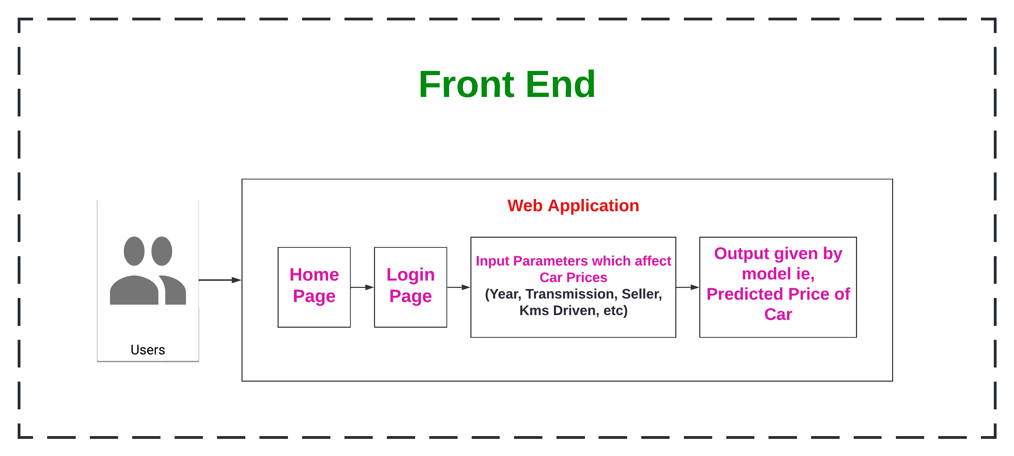
System Architecture

Slide 17
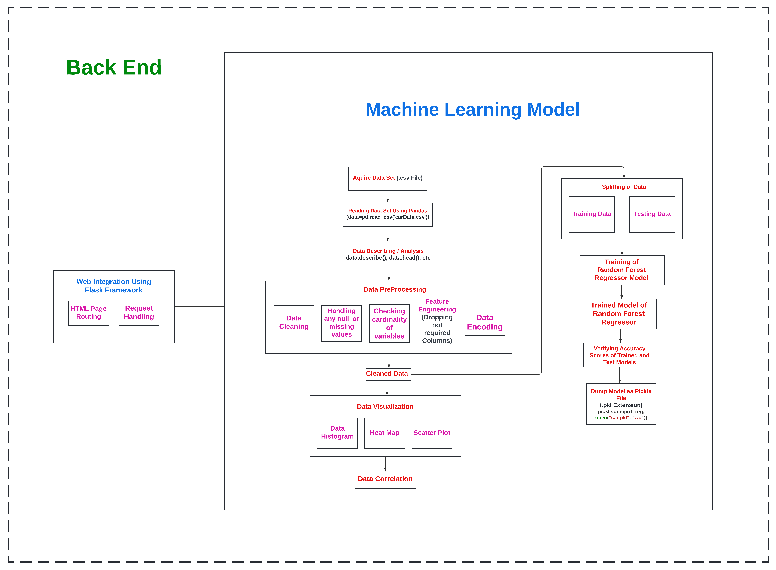

Slide 18
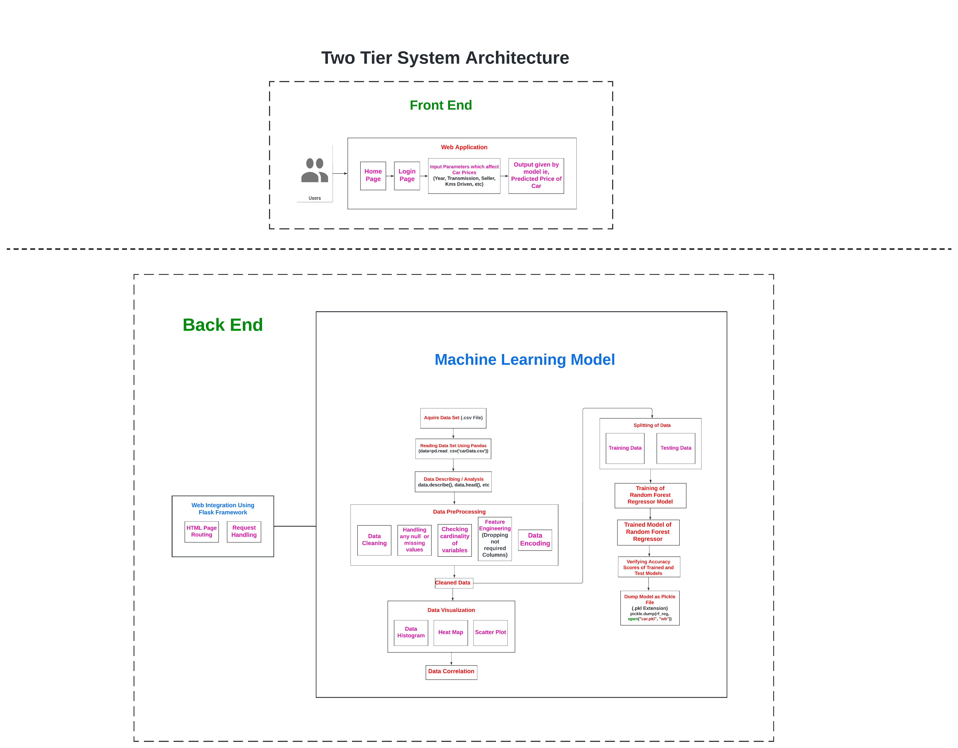

Slide 19
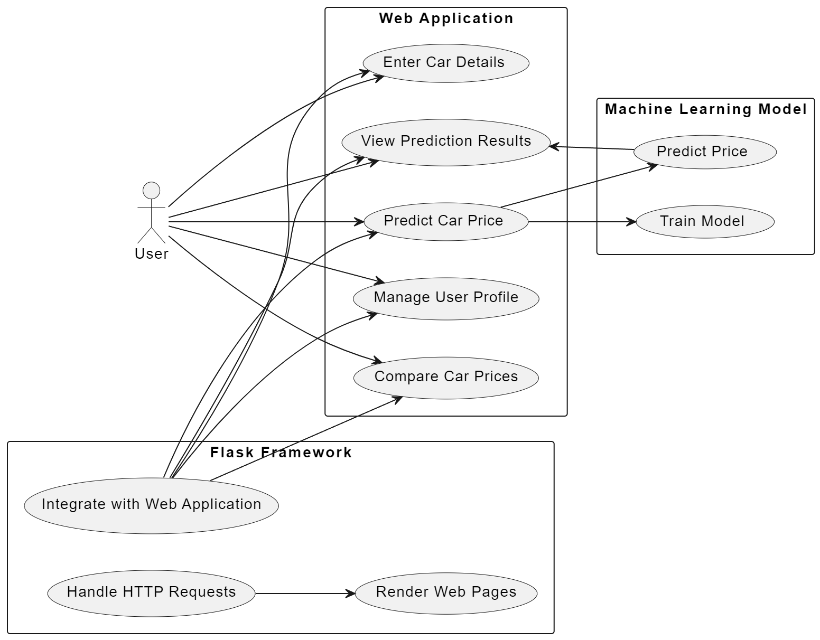
System Design (UML Diagrams)
USE CASE DIAGRAM

Slide 20
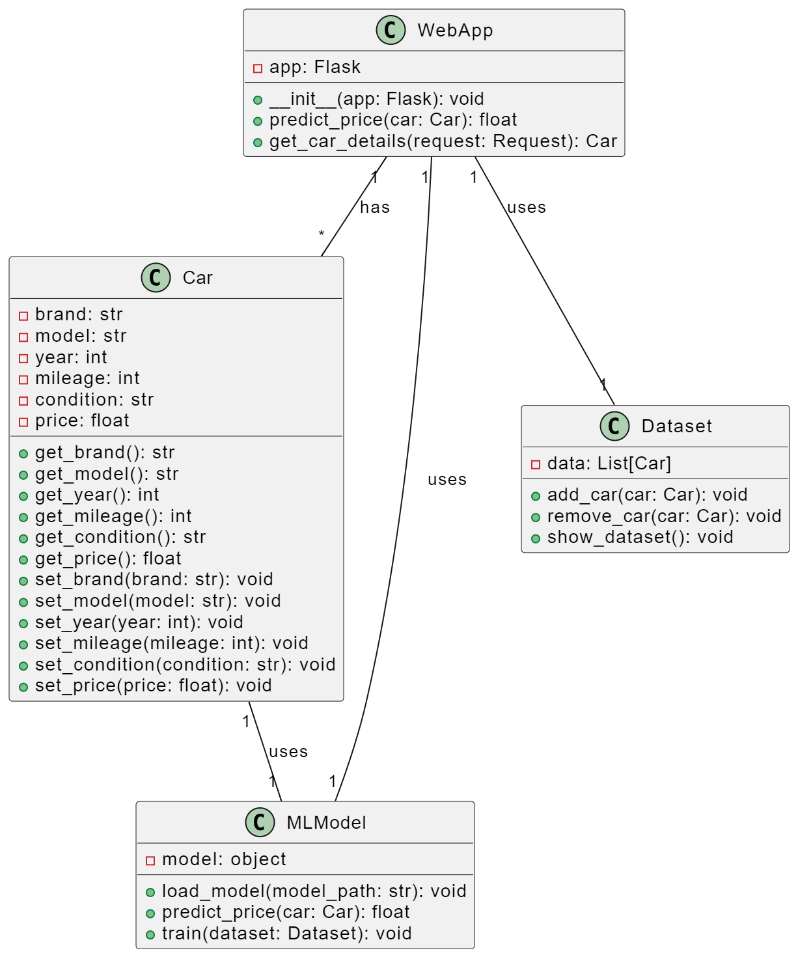
2. Class Diagram

Slide 21
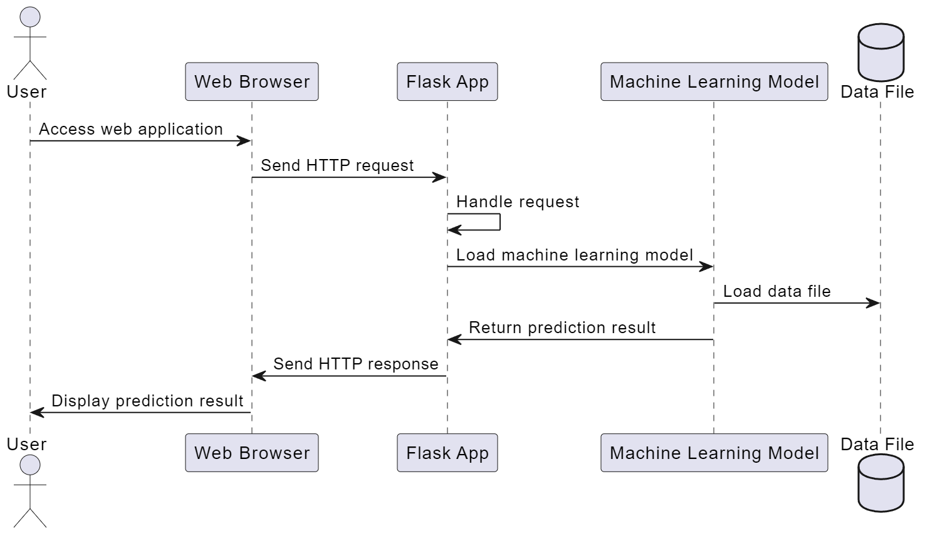
3. SEQUENCE DIAGRAM

Slide 22
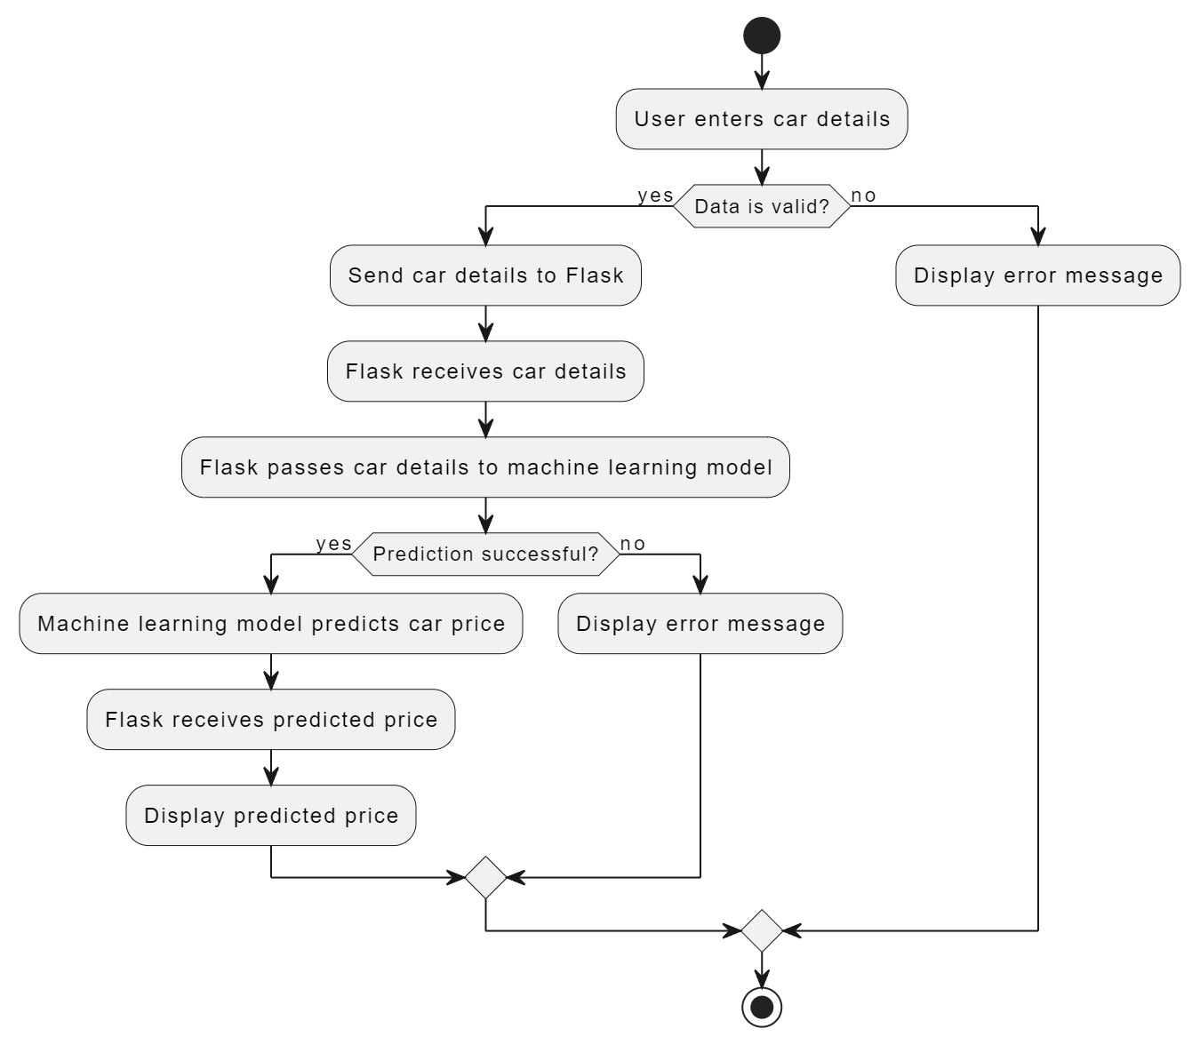
4. ACTIVITY DIAGRAM

Slide 23
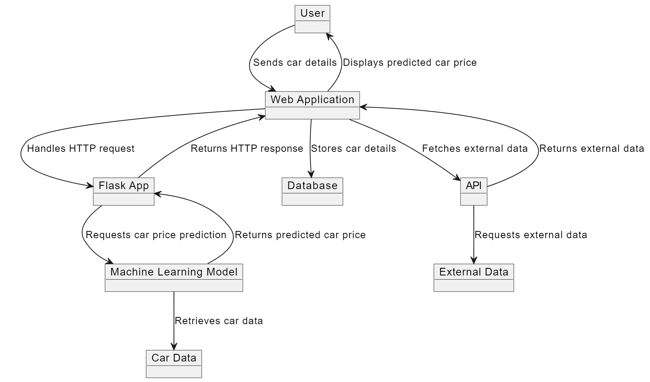
5. OBJECT DIAGRAM

Slide 24
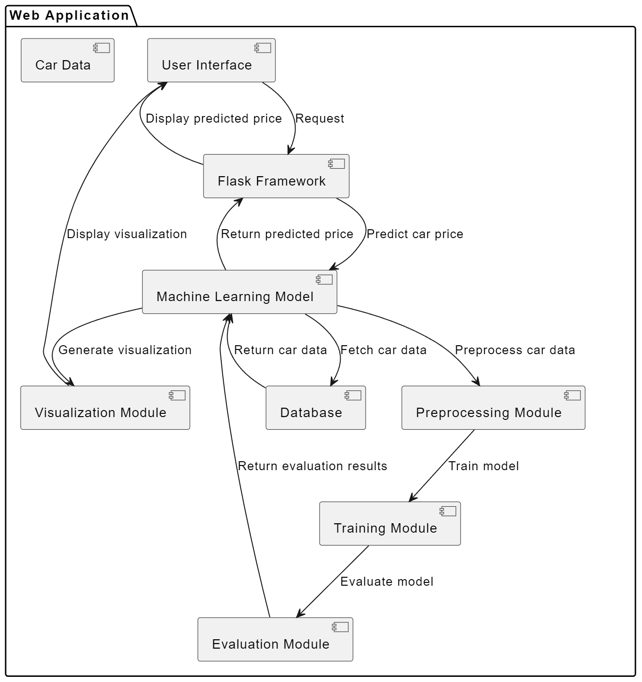
6. COMPONENT DIAGRAM

Slide 25
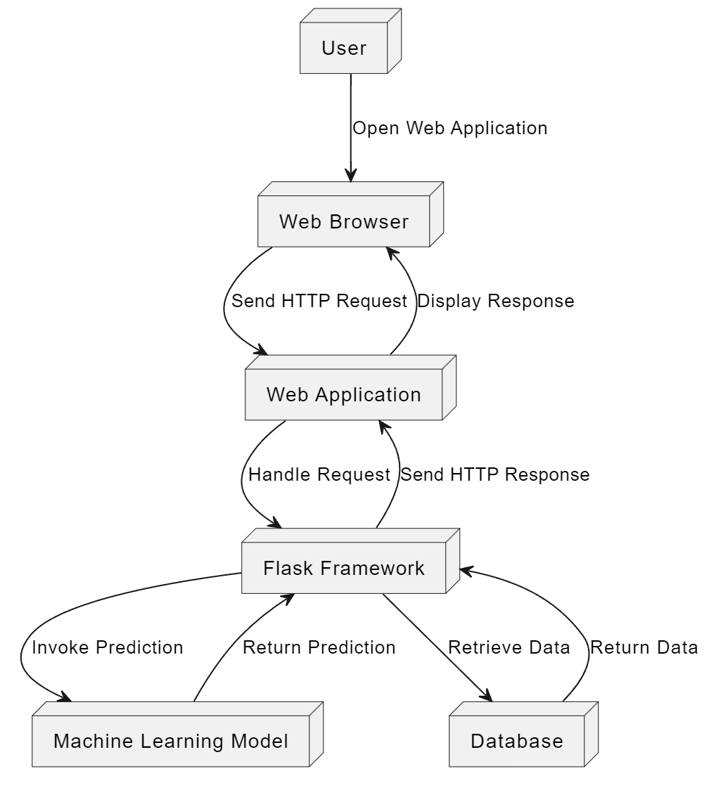
7. DEPLOYMENT DIAGRAM

Slide 26
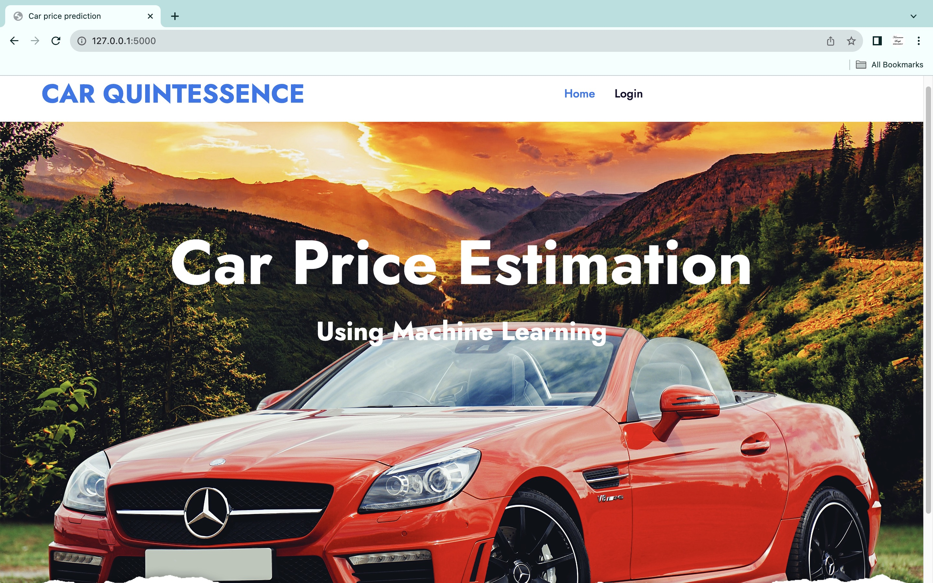
SCREEN SHOTS
1. HOME PAGE

Slide 27
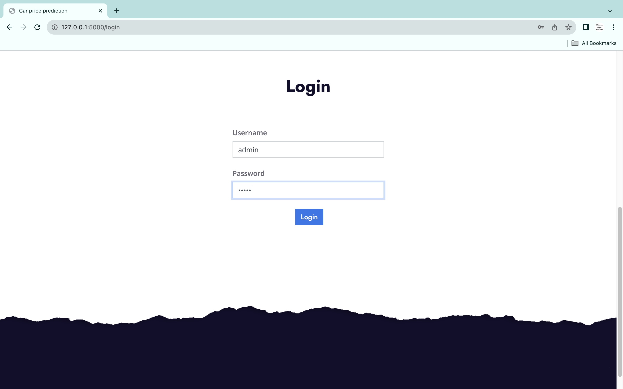
2. LOGIN PAGE

Slide 28
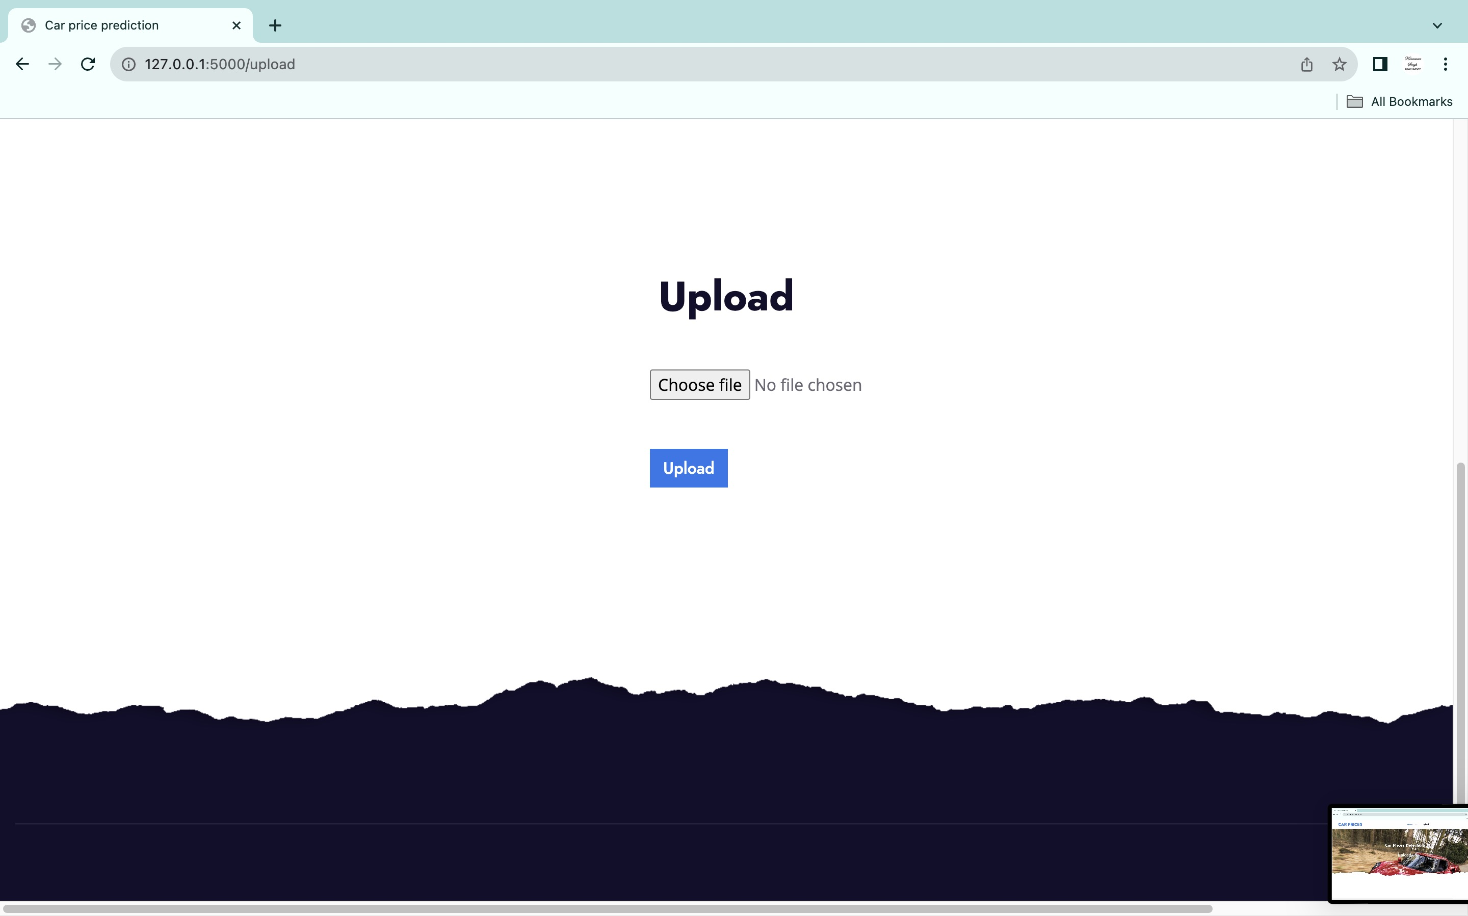
3. UPLOAD .CSV FILE

Slide 29
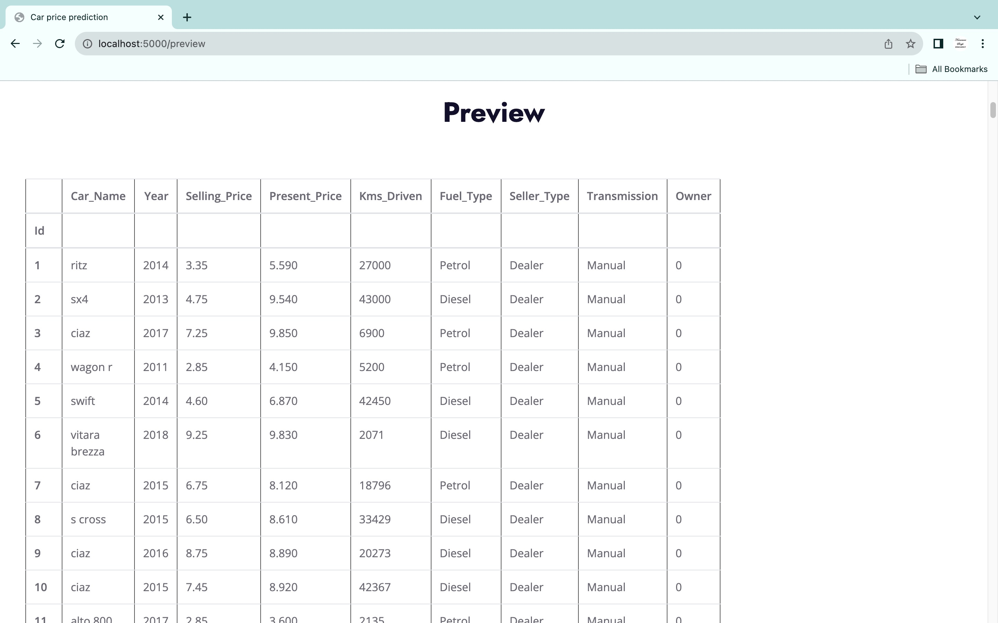
4. PREVIEW DATA FRAME

Slide 30
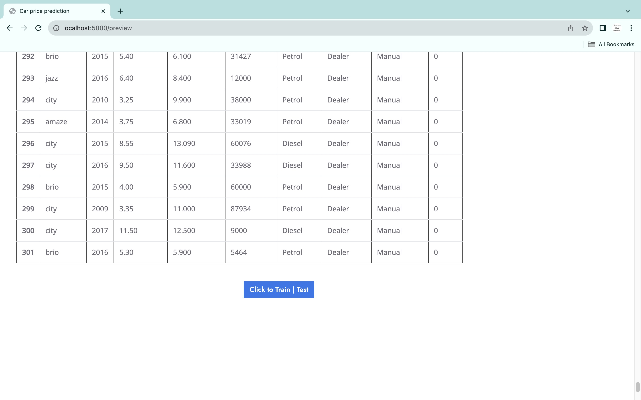
5. TRAIN THE MACHINE LEARNING MODEL

Slide 31
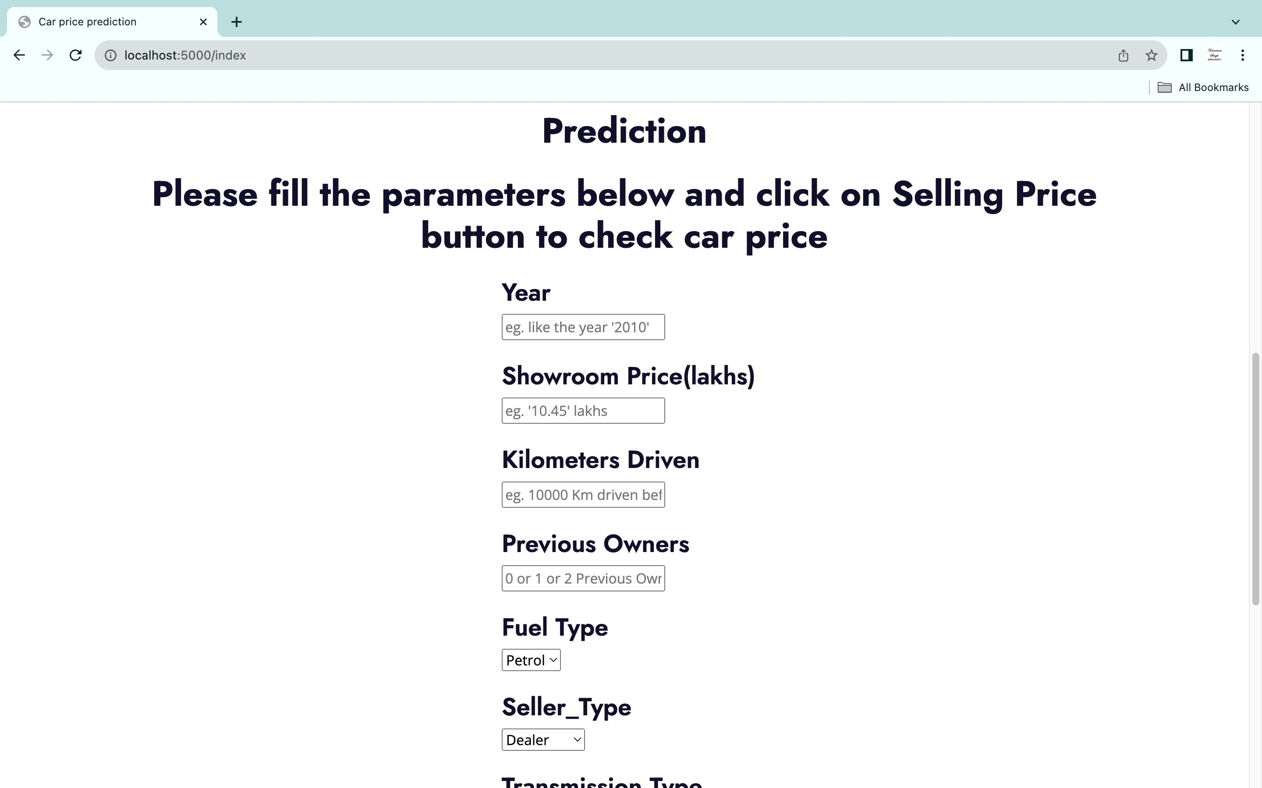
6. ENTERING CAR PARAMETERS

Slide 32
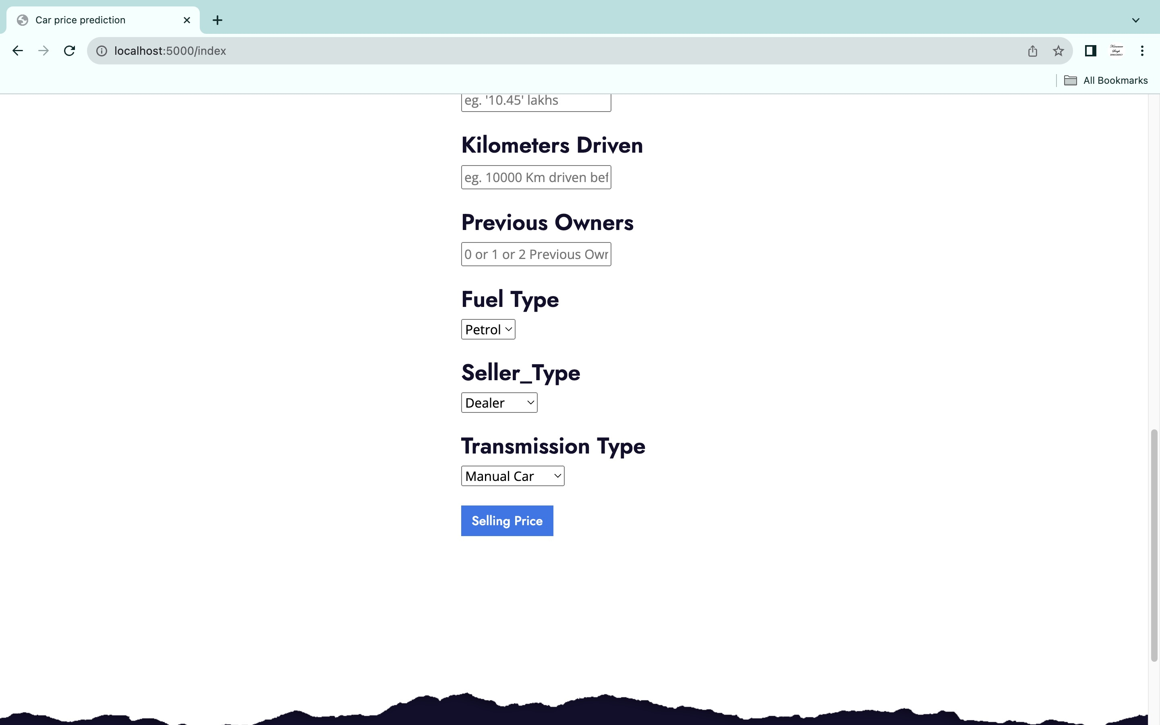
7. ENTERING CAR FEATURES

Slide 33
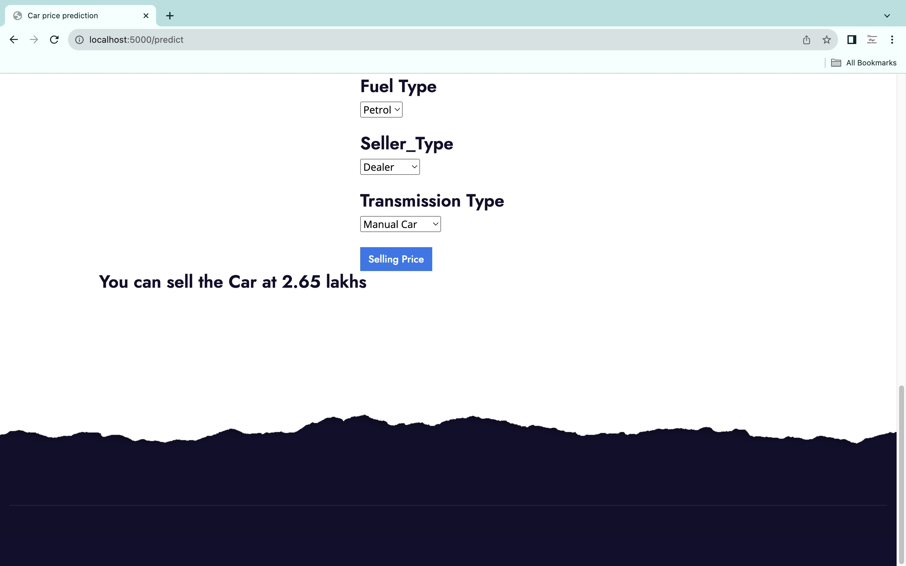
8. PREDICTED CAR PRICE (OUTPUT)

Slide 34
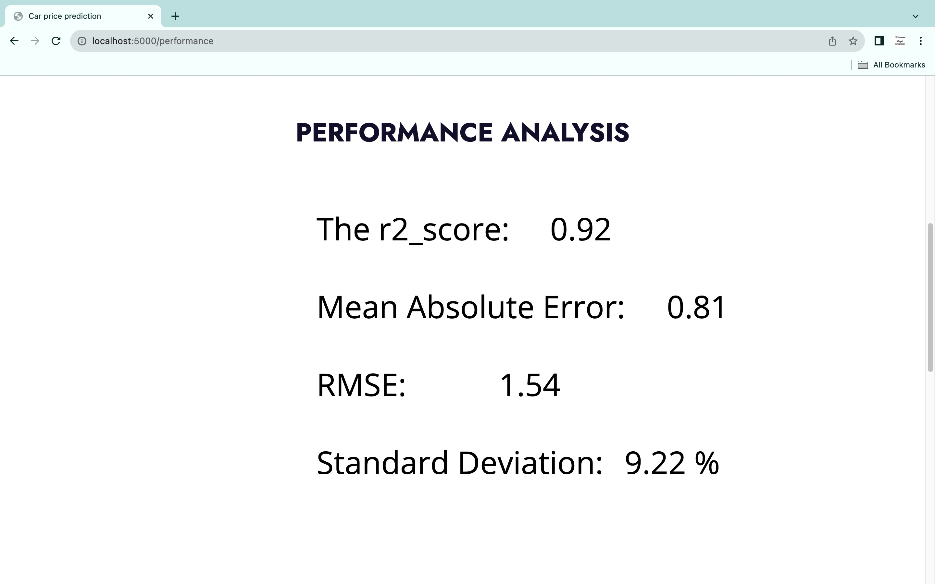
9. PERFORMANCE OF THE MODEL

Slide 35
CONCLUSION
Car price prediction poses a formidable challenge due to the multitude of attributes crucial for accurate estimations. A pivotal phase in this process involves data collection and preprocessing. In this research, data normalization, standardization, and cleaning were executed through a dedicated script, mitigating unnecessary noise for machine learning algorithms. Although data cleaning significantly enhances prediction performance, it proved insufficient for the complexities inherent in the dataset. Employing other machine learning algorithms resulted in an accuracy below 50%. Consequently, this project proposes the Random Forest Algorithm Regression approach, achieving a notable accuracy of ~92%. This marked improvement underscores the effectiveness of this approach. However, it is acknowledged that this system demands more computational resources than other machine learning algorithms.

Slide 36
REFERENCES
[1] A. Das Mou, P. K. Saha, S. A. Nisher and A. Saha, "A Comprehensive Study of Machine Learning algorithms for Predicting Car Purchase Based on Customers Demands," 2021 International Conference on Information and Communication Technology for Sustainable Development (ICICT4SD), Dhaka, Bangladesh, 2021,IEEE, pp. 180-184, doi: 10.1109/ICICT4SD50815.2021.9396868.
[2] J. C. Pope and J. Silva-Risso, “The psychological effect of weather on car purchases* meghan r. busse devin g. pope,” The Quarterly Journal of Economics, vol. 1, no. 44, p. 44, 2014.
[3] M. Jayakameswaraiah and S. Ramakrishna, “Development of data mining system to analyze cars using tknn clustering algorithm,” In- ternational Journal of Advanced Research in Computer Engineering Technology, vol. 3, no. 7, 2014.
[4] F.Harahap,A.Y.N.Harahap,E.Ekadiansyah,R.N.Sari,R.Adawiyah, and C. B. Harahap, “Implementation of na ̈ıve bayes classification method for predicting purchase,” in 2018 6th International Conference on Cyber and IT Service Management (CITSM). IEEE, 2018, pp. 1–5.
[5] K. S. Durgesh and B. Lekha, “Data classification using support vector machine,” Journal of theoretical and applied information technology, vol. 12, no. 1, pp. 1–7, 2010.
[6] R. Ragupathy and L. Phaneendra Maguluri, “Comparative analysis of machine learning algorithms on social media test,” International Journal of Engineering and Technology(UAE), vol. 7, pp. 284–290, 03 2018.

Slide 37
[7] N.Pal,P.Arora,P.Kohli,D.Sundararaman,andS.S.Palakurthy,“How much is my car worth? a methodology for predicting used cars prices using random forest,” in Future of Information and Communication Conference. Springer, 2018, pp. 413–422.
[8] S. Pudaruth, “Predicting the price of used cars using machine learning techniques,” Int. J. Inf. Comput. Technol, vol. 4, no. 7, pp. 753–764, 2014.
[9] F. Osisanwo, J. Akinsola, O. Awodele, J. Hinmikaiye, O. Olakanmi, and J. Akinjobi, “Supervised machine learning algorithms: classification and comparison,” International Journal of Computer Trends and Technology (IJCTT), vol. 48, no. 3, pp. 128–138, 2017.
[10] M. R. Busse, D. G. Pope, J. C. Pope, and J. Silva-Risso, “The psychological effect of weather on car purchases,” The Quarterly Journal of Economics, vol. 130, no. 1, pp. 371–414, 2015.
[11] S. Veni and A. Srinivasan, “Defect classification using na ̈ıve bayes classification,” Interbational Journal of Applied Engineering Research, vol. 12, no. 22, pp. 12 693–12 700, 2017.
[12] E. Gegic, B. Isakovic, D. Keco, Z. Masetic, and J. Kevric, “Car price prediction using machine learning techniques,” 2019.
[13] M. Jabbar, “Prediction of heart disease using k-nearest neighbor and particle swarm optimization,” Biomed. Res, vol. 28, no. 9, pp. 4154– 4158, 2017.

Slide 38
FUTURE ENHANCEMENTS
Although, this system has achieved astonishing performance in car price prediction problem our aim for the future research is the following:-
DYNAMIC PRICE PREDICTION MODELS:
Implement dynamic pricing models that consider real-time market trends, economic factors, and emerging technologies, providing users with even more accurate and up-to-date car price predictions.
USER CUSTOMIZATION AND PREFERENCES: Introduce user profiles where individuals can set preferences, allowing the
system to tailor predictions based on specific criteria like brand loyalty,
environmental consciousness, or desired features.

Slide 39
INCORPORATION OF EXTERNAL DATASETS:
Enhance the dataset by integrating external sources such as automotive industry reports, consumer sentiment data, and environmental impact assessments to further refine predictions and provide a holistic view of the market.
INTERACTIVE DATA VISUALIZATIONS: Develop interactive visualizations that allow users to explore and interpret the factors influencing car prices, promoting a deeper understanding of the prediction model and fostering user engagement.
GEO-SPECIFIC PRICE INSIGHTS:
Provide geographically specific insights into regional pricing variations, considering factors like local demand, supply chain dynamics, and economic conditions to offer users location-specific predictions.

Slide 40
INTEGRATION OF ADVANCED MACHINE LEARNING ALGORITHMS: Explore and integrate advanced machine learning algorithms beyond Random Forest, such as neural networks or gradient boosting, to evaluate their impact on prediction accuracy and enhance the system's capabilities.
MOBILE APPLICATION INTEGRATION:
Develop a mobile application to extend the accessibility of the car price prediction system,enabling users to input parameters and receive predictions conveniently on their smartphones.
HISTORICAL PRICE TRENDS ANALYSIS: Implement a feature that analyzes historical car price trends, allowing users to track how prices have evolved over time and providing valuable insights for predicting future trends.

Slide 41
THANK YOU
THANK YOU

